Slide 1

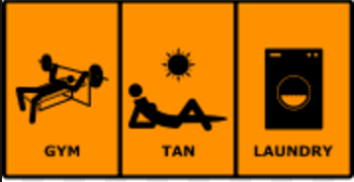
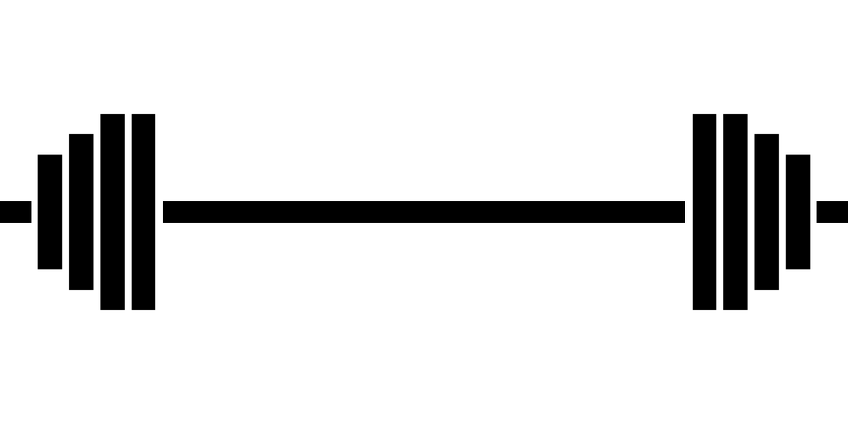
Gym, Tan, Linear Regression
Crowdedness at the Campus Gym
By: Noura Azeem, Brendan Cox, Anna Heffernan

Slide 2
Question:
Can we predict the number of people in the gym at a given time?
Prediction:
Most populated gym times would be evenings, Sundays, beginnings of semesters, but not on holidays.

Slide 3
Arrival to Question:
Trend tends to be seen around GW’s campus, so we are seeing if this is applicable to the dataset at UC Berkeley (downloaded from Kaggle).
-Treadmills after new years
-Gym before summer months

Slide 4
Data and Variables
Dependent Variable:
Number of people (n = 26,000)
Independent Variables:
date (string; datetime of data)
timestamp (int; number of seconds since beginning of day)
day_of_week (int; 0 [monday] - 6 [sunday])
is_weekend (int; 0 or 1) [boolean, if 1, it's either saturday or sunday, otherwise 0]
Is_during_semester (int; 0 or 1) [boolean, if 1 it's during school semester, 0 otherwise]
is_holiday (int; 0 or 1) [boolean, if 1 it's a federal holiday, 0 otherwise]
temperature (float; degrees fahrenheit)
is_start_of_semester (int; 0 or 1) [boolean, if 1 it's the beginning of a school semester, 0 otherwise]
month (int; 1 [jan] - 12 [dec])
hour (int; 0 - 23)

Slide 5
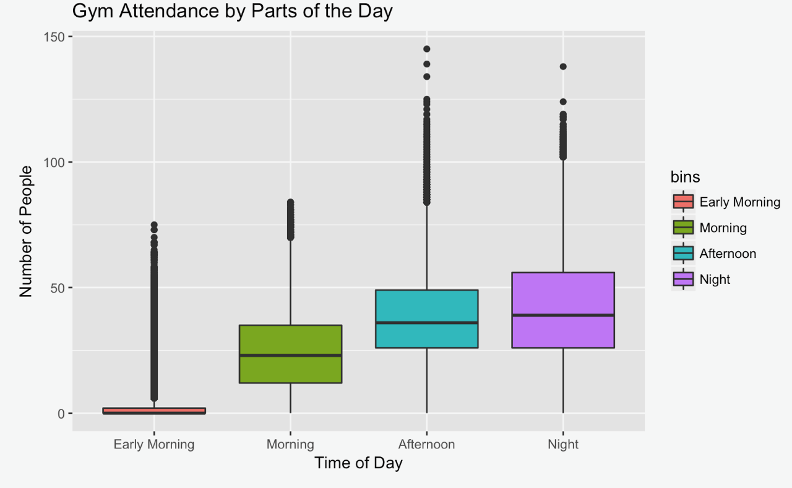
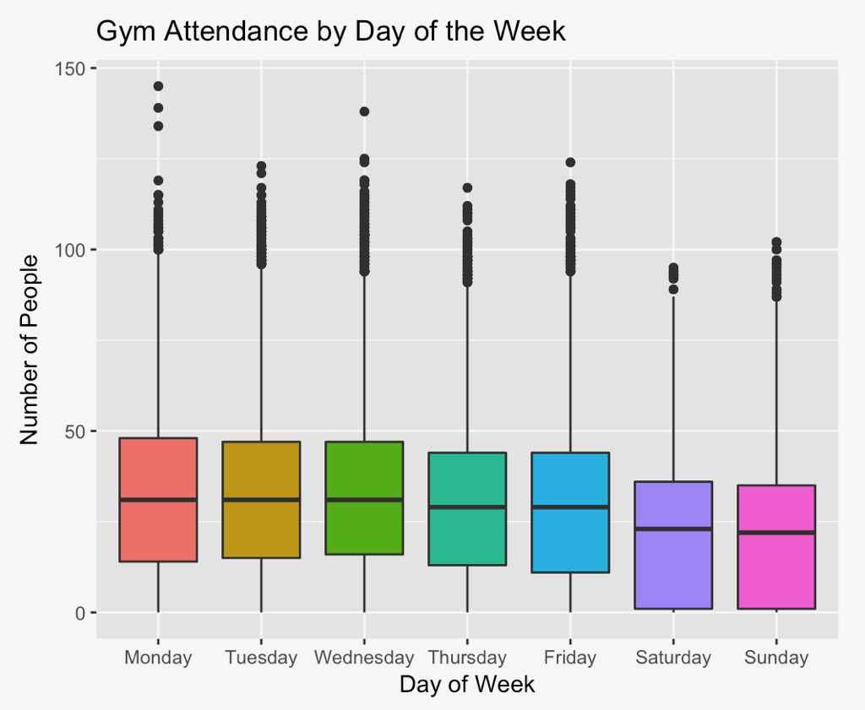
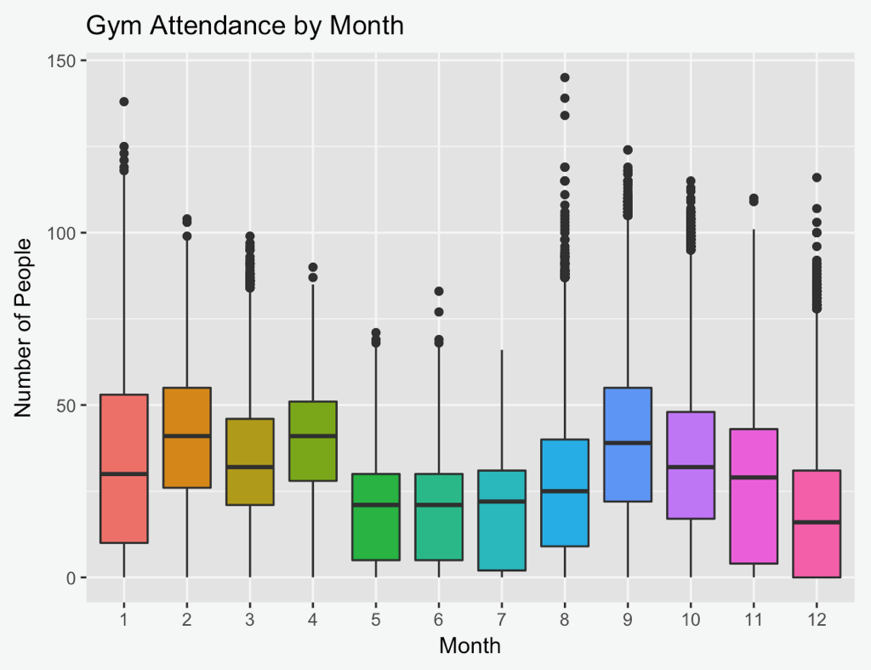
Gym Attendance by Parts of the Day

Slide 6
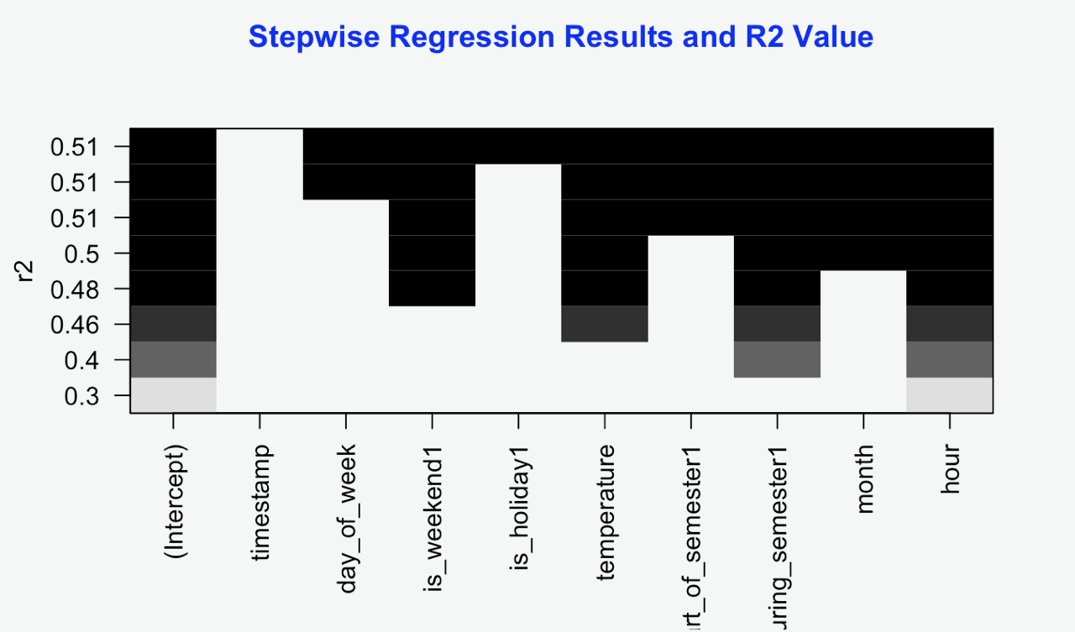
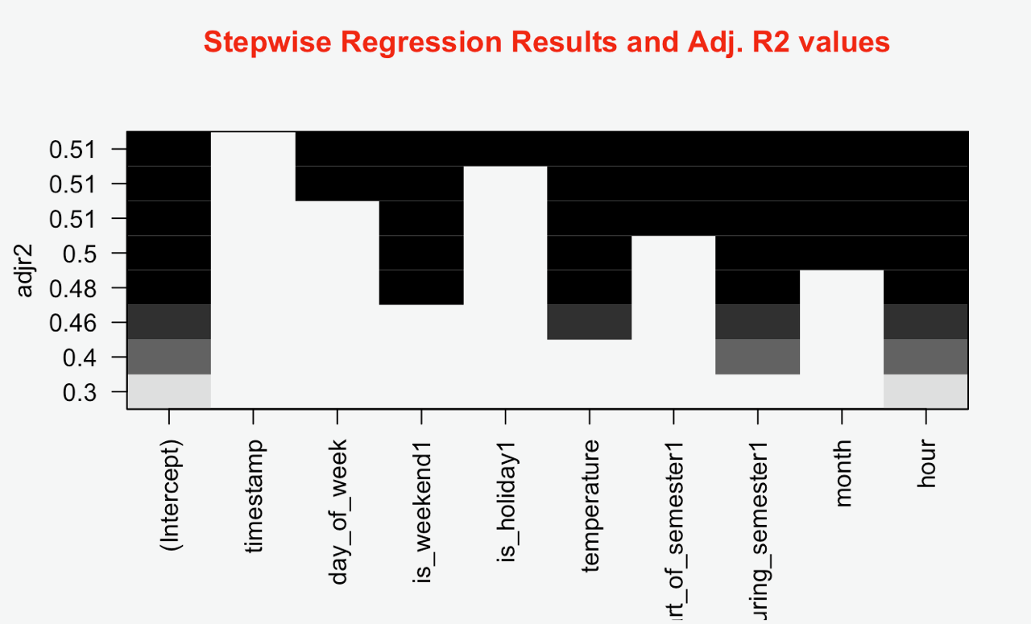
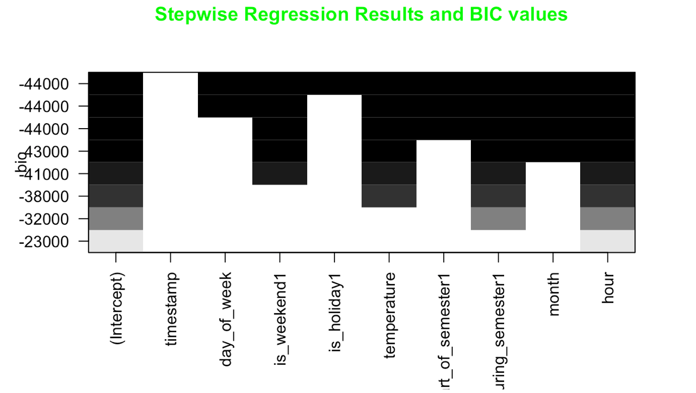
Regression model
Consistent results for all 3 methods, all variables considered are significant

Slide 7
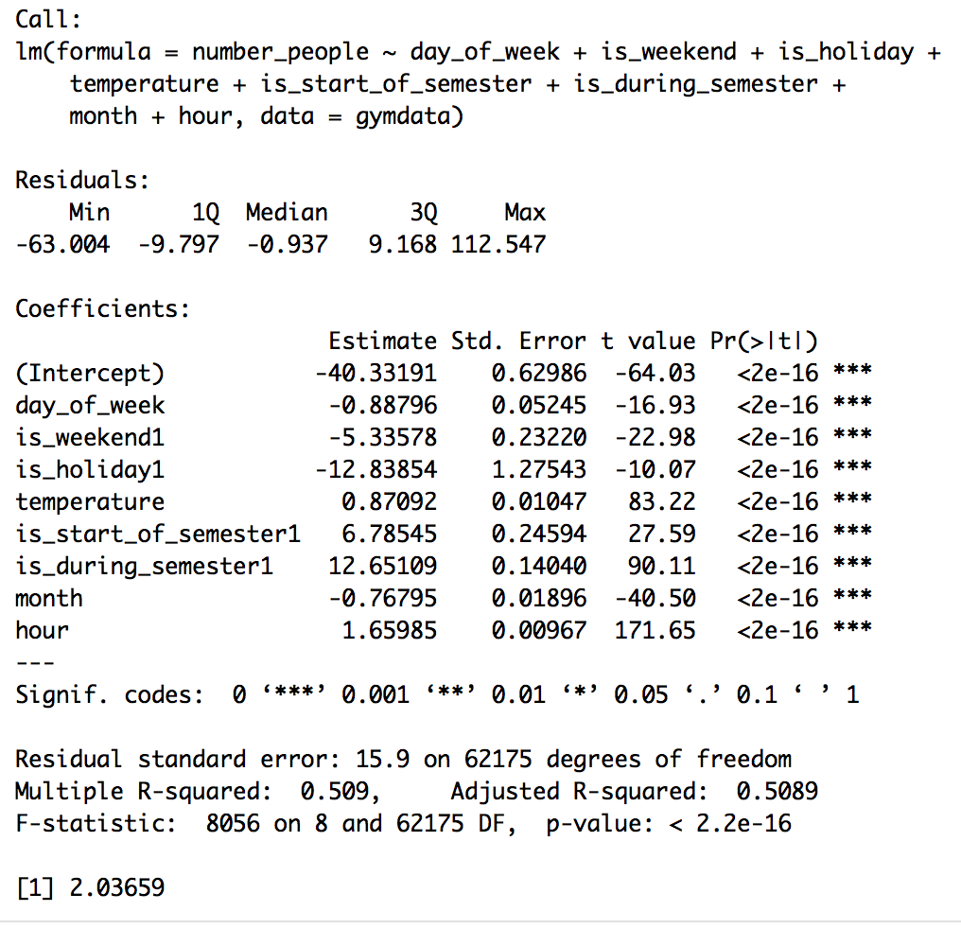
Regression Model and VIF Level
Stepwise Regression used (exhaustive method)
More evidence regarding significance of variables
VIF of ~2, means moderate correlation

Slide 8


Predictions from Model
We predicted the busiest time would be on Sunday, at the beginning of the semester, evening (~6 pm). Looked at January.
We tested another time: on a Friday, at 6 pm, not at the beginning of the semester, not on a holiday, when it is 72 degrees, in April
Busiest day was August 24th, 1 pm, Monday, before the start of the semester (26th), when it was 66.87 degrees.
Our prediction was wrong!

Slide 9
Reliability/Potential improvements
R2 = .509
P-value near 0
College campus gyms around the US
Not all college gyms are 24/7
More years of data = we could do time series analysis
Some multicollinearity (start of semester and is during semester)

Slide 10

Thank you!
Questions?
https://www.kaggle.com/nsrose7224/crowdedness-at-the-campus-gym/

